Slide 1

KUDO - Kubernetes Universal Declarative Operator Technical Review
James Dyckowski – Sr. Sales Engineer

Slide 2


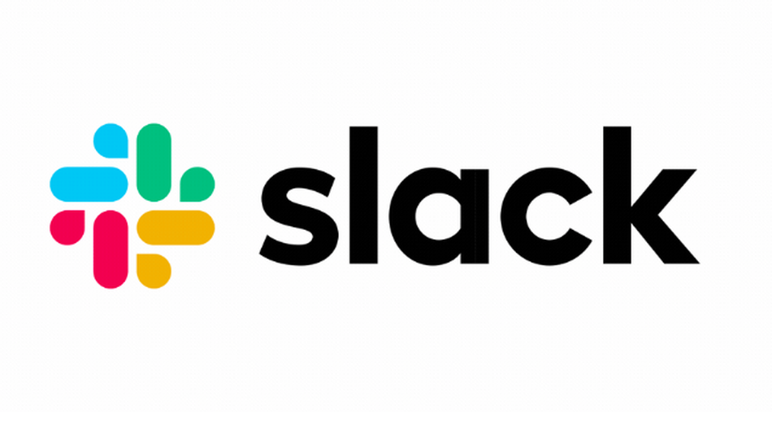


KUDO Community - Get Involved!
https://kudo.dev/
https://github.com/kudobuilder/kudo
#kudo http://slack.k8s.io/
https://groups.google.com/forum/#!forum/kudobuilder
Community Meeting - weekly Thursdays 10am PT

Slide 3
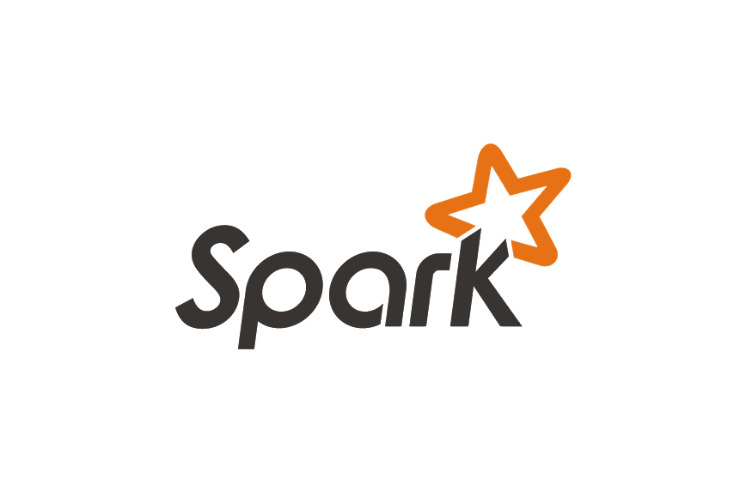
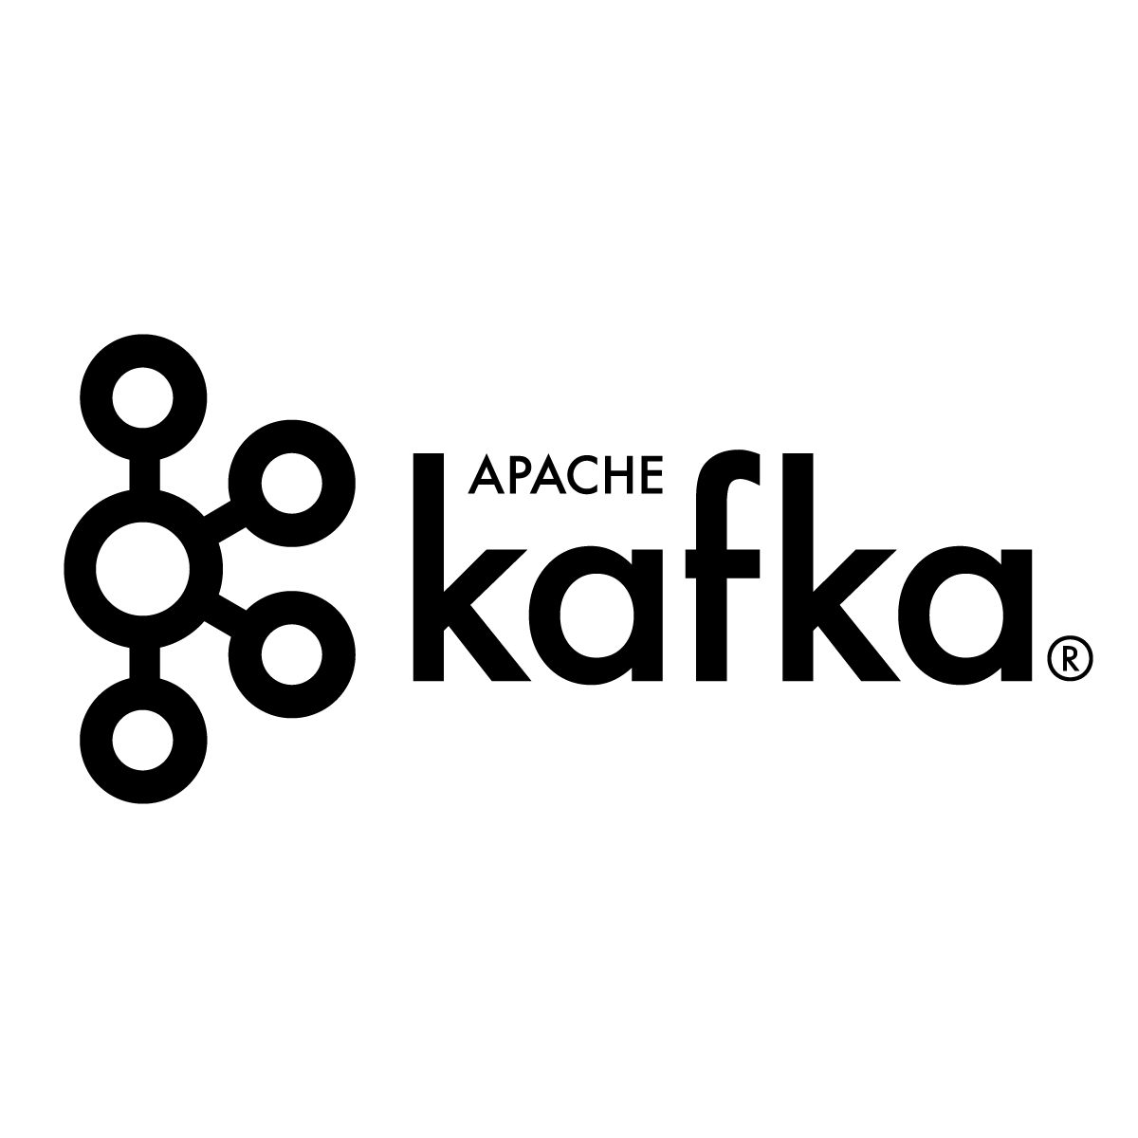
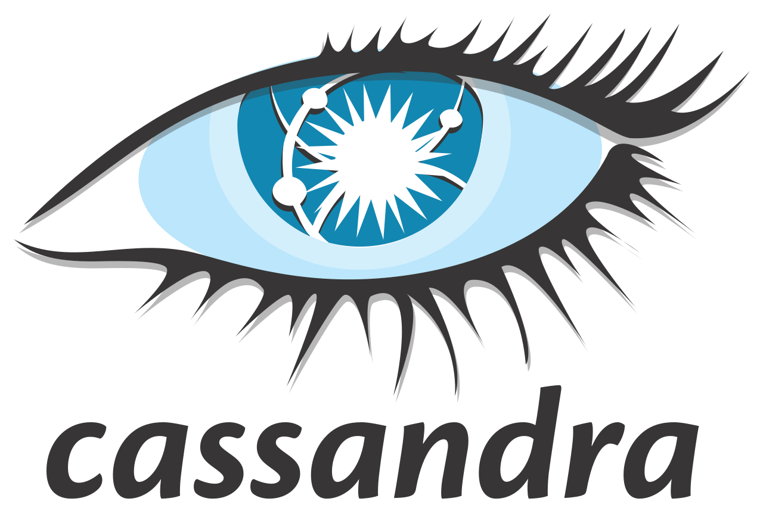
KUDO Operators
Beta in October
GA in October
Beta in October
Notes:
When we started to look at the operator landscape, it seemed like this was a familiar problem space. We saw developers having to implement the same steps, with a lot of complexity being expressed in number of lines of code and time to implement. So taking the lessons we’d learned from the dcos-commons SDK, we created the Kudo project with the aim of simplifying operator development.
Kudo is an acronym for Kubernetes Universal Declarative Operator. Rather than implementing a custom operator for each application, Kudo provides a universal operator with the concepts of plans built into it, and allowing operator developers to define a lot of the code declaratively in YAML. Kudo is built on top of kubebuilder, so you can also think of it as a way of simplifying kubebuilder based development. It’s a fully open source project, and we’re actively working to build community around it.
The Kubernetes Universal Declarative Operator (KUDO) is a highly productive toolkit for writing Kubernetes Operators, with a focus on Day 2 operations for distributed data services.
Includes a universal controller that can be configured via declarative YAML specs to manage multiple workloads
Inspired by DC/OS Commons, a similar toolkit for orchestrating data services on Apache Mesos

Slide 4
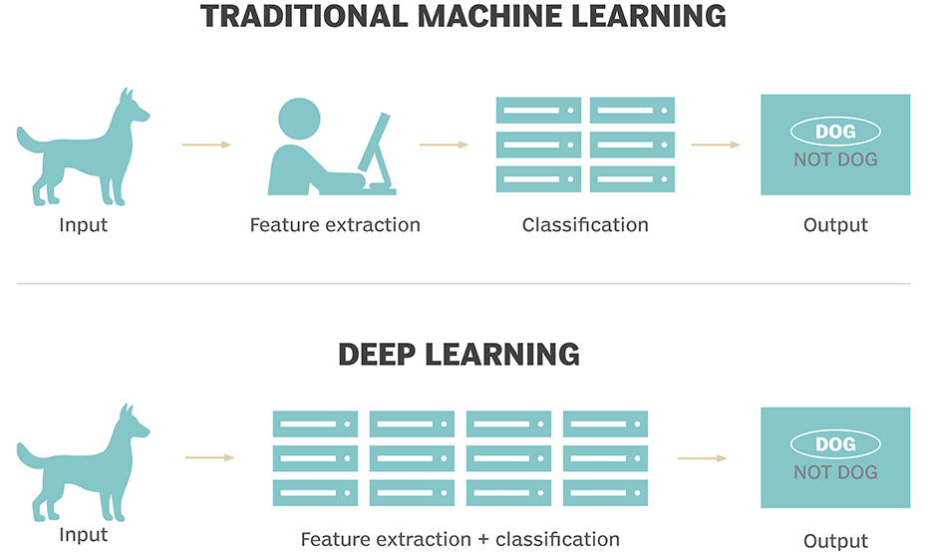
Deep Learning the Promise

Slide 5


Tensorflow
“An open-source software library for Machine Intelligence” - tensorflow.org
Tensorflow is a software library that makes it easy for developers to construct artificial neural networks to analyze their data of interest
Dataflow Executor, Compute Kernel Implementations, Networking, etc.
GPUs
Python
TensorFlow Library
CPUs

Slide 6
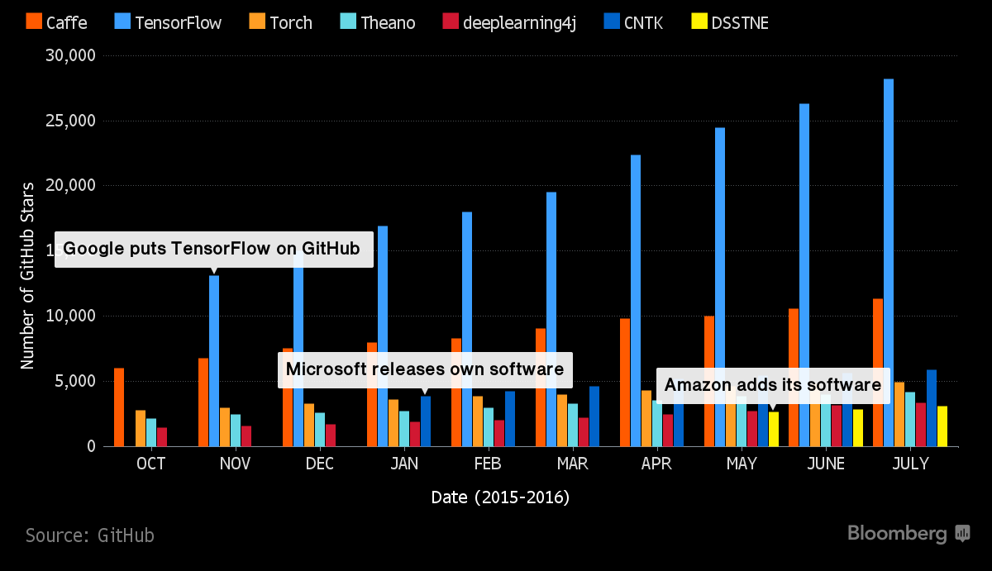
Notes:
There are a bunch of popular frameworks. Tensorflow is most popular.

Slide 7

Deep Learning Challenges
Problems once off laptop
Distributed data storage
Data preparation
Data exploration
Distribution model training
Monitoring
Debugging
Model serving

Slide 8






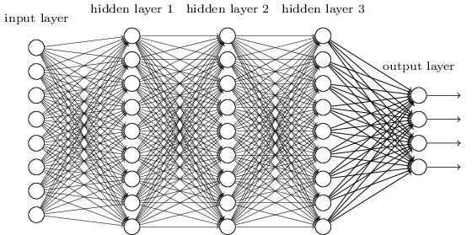
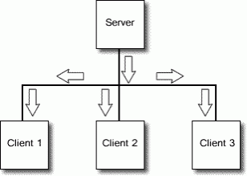
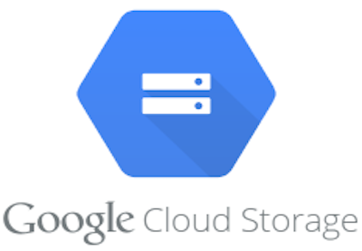


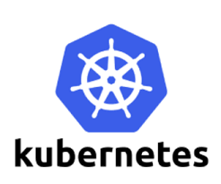

Deep Learning Pipeline
Monitoring & Operations
Data & Streaming
Users
Frameworks & Cluster
Models
Model Serving
Distributed Data Storage and Streaming
Data Preparation and Analysis
Deep Learning Tools and Distributed Hosting
Building Machine Learning Model
Sending Model to Clients

Slide 9
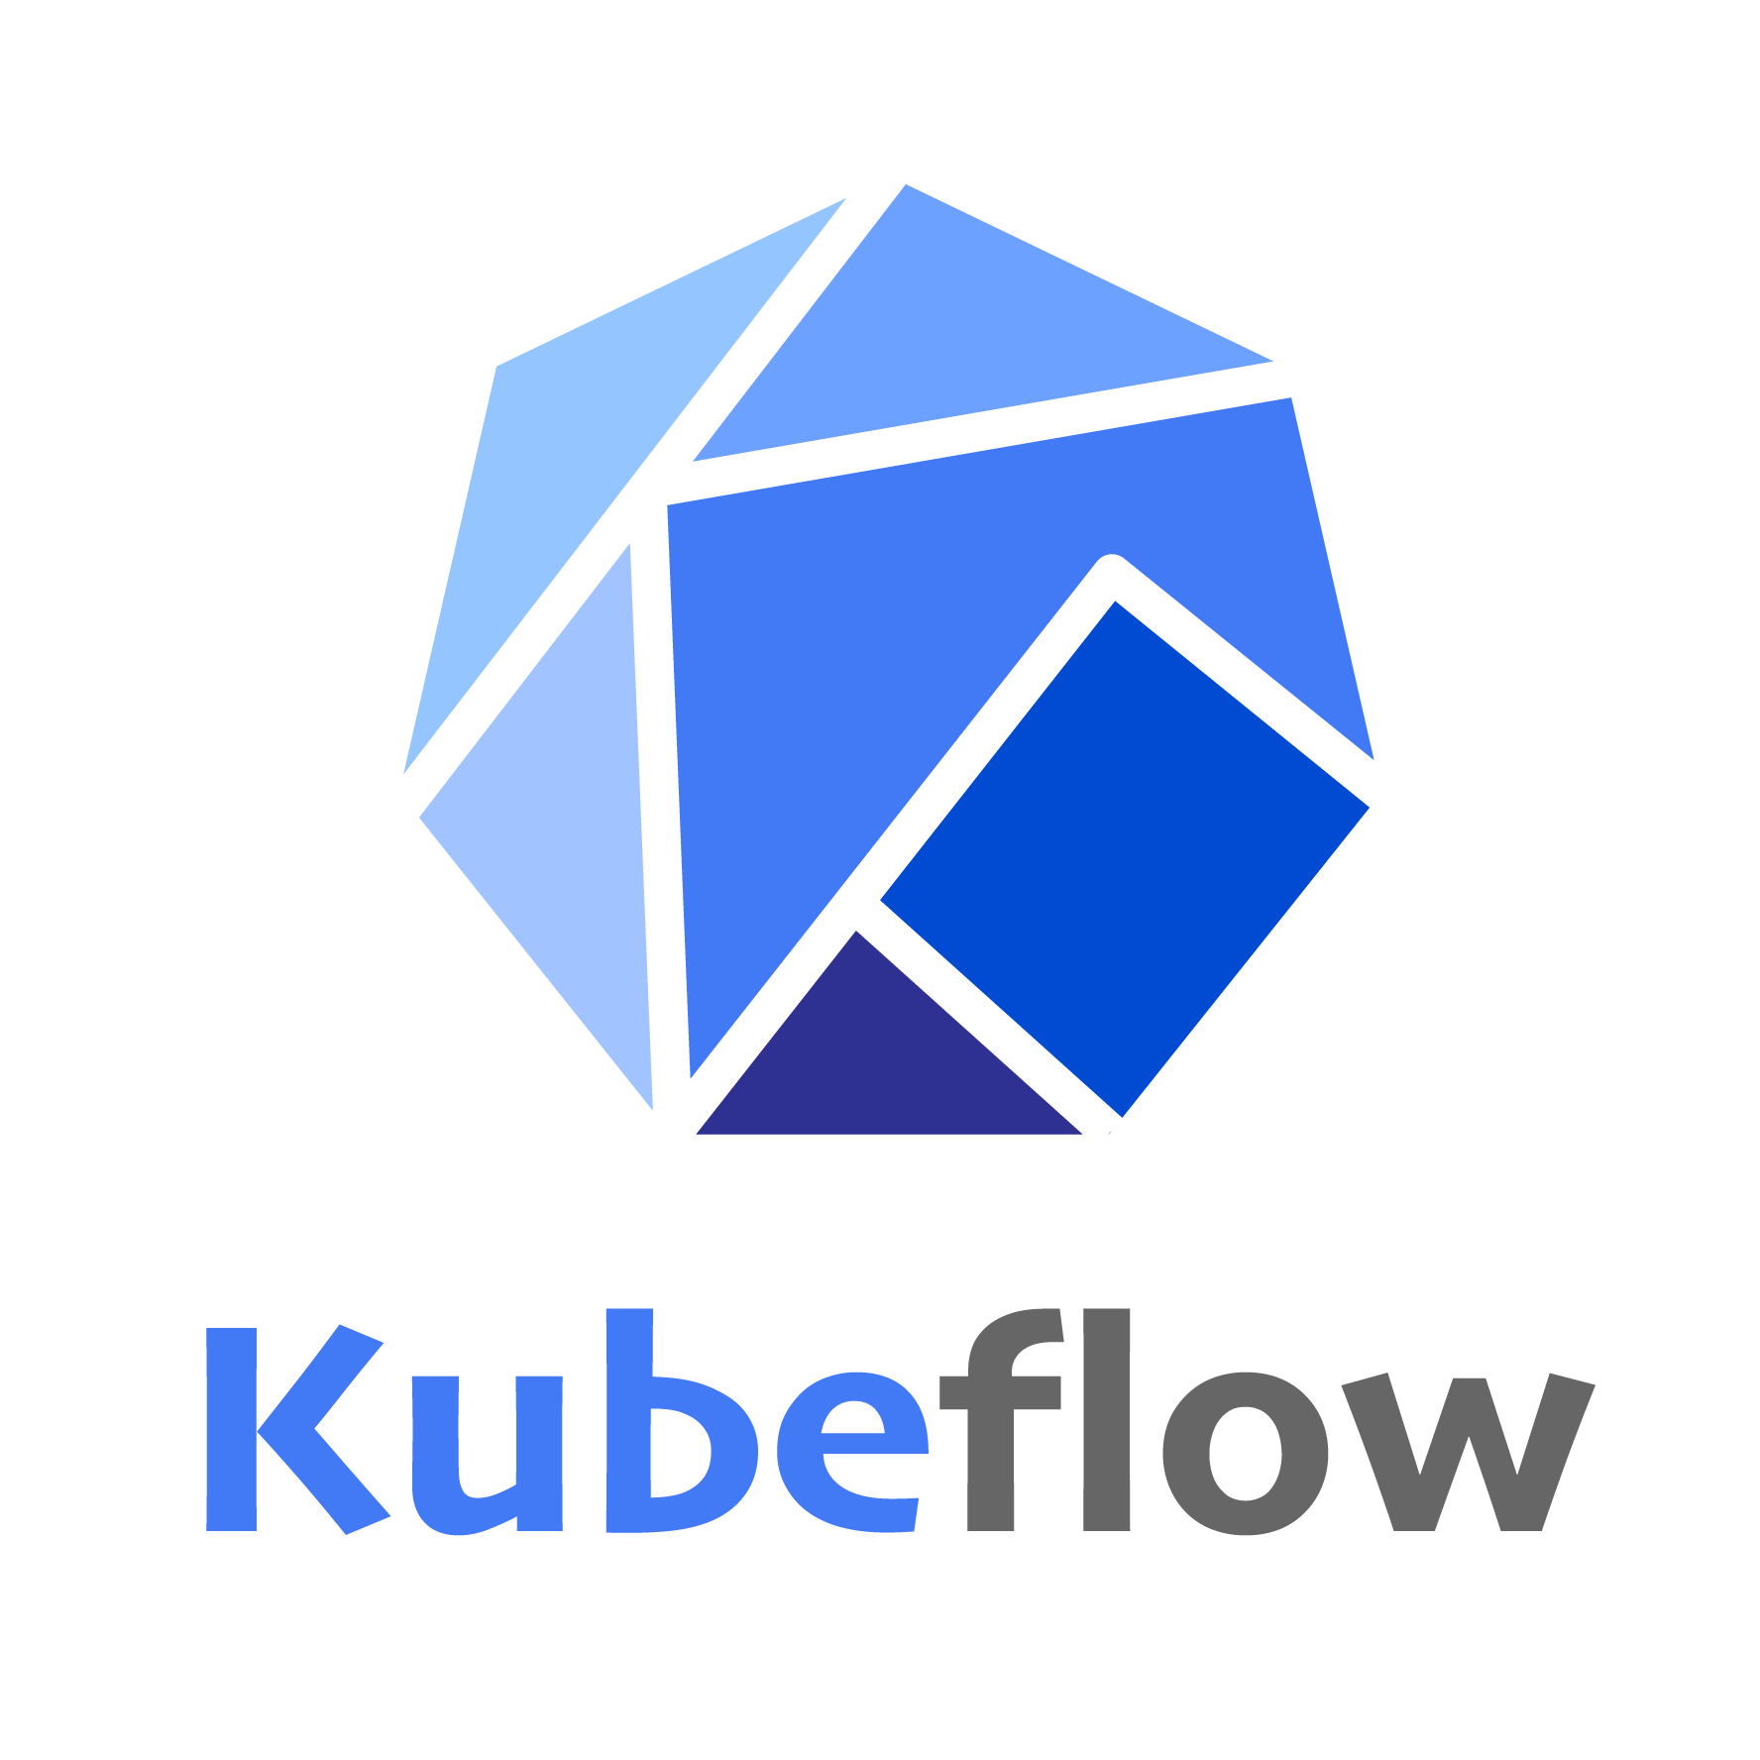


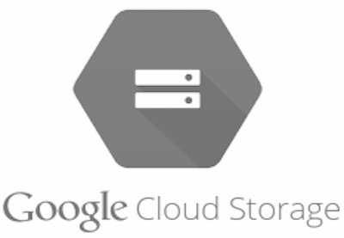



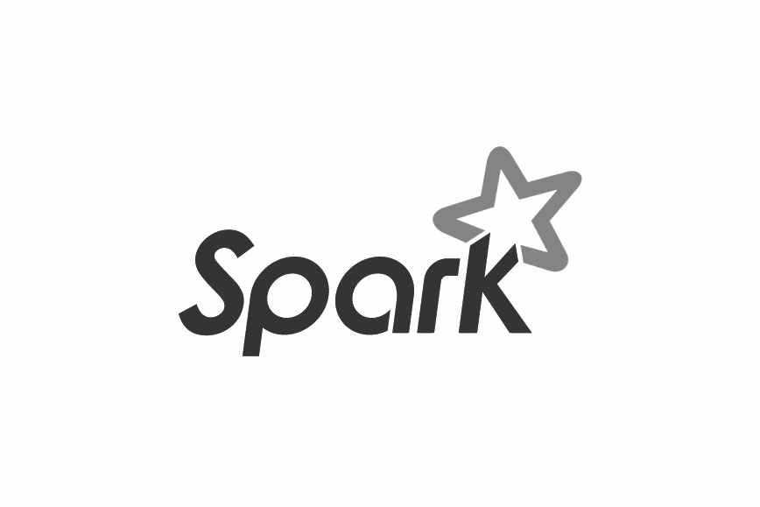
Kubeflow Automation
Data & Streaming
Users
Frameworks & Cluster
Models
Model Serving
Distributed Data Storage and Streaming
Data Preparation and Analysis
Deep Learning Tools and Distributed Hosting
Building Machine Learning Model
Sending Model to Clients

Slide 10
Kubeflow for Deep Learning
Automates distribution of deep learning
Jupyter Notebook
Tensorflow (and more)
Currently on Kubernetes
Requires few steps / running familiarity with Ksonnet

Slide 11
KUDO Operators + Kubeflow
Monitoring & Operations
Data & Streaming
Users
Frameworks & Cluster
Models
Model Serving
Distributed Data Storage and Streaming
Data Preparation and Analysis
Deep Learning Tools and Distributed Hosting
Distributed Data Storage and Streaming
Sending Model to Clients
Notes:
Giving you choice of tools with application aware automation and best way to manage with intelligent resource pooling.

Slide 12
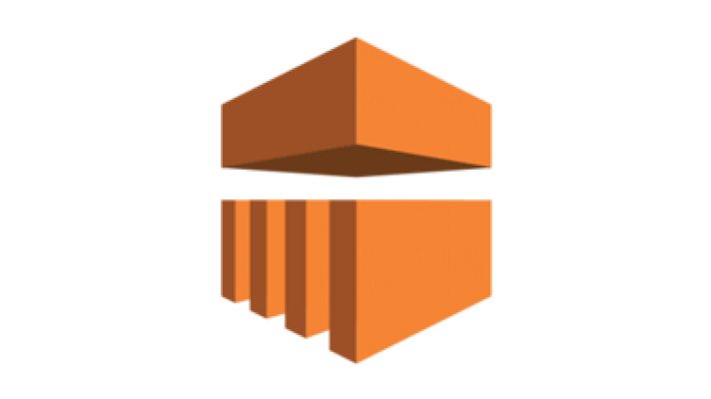
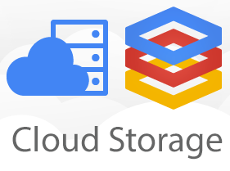
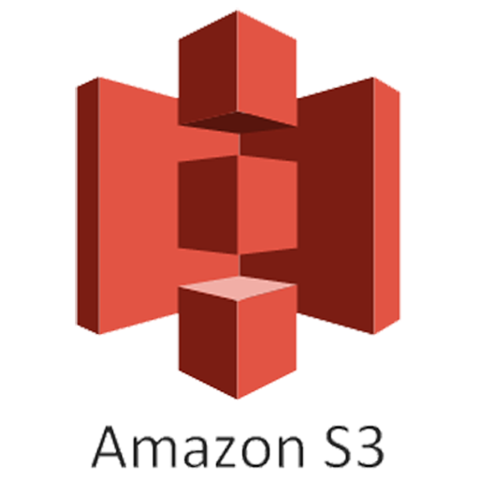


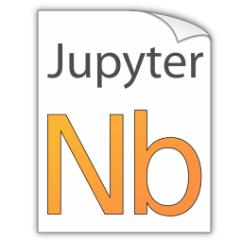

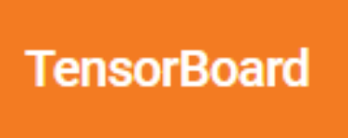
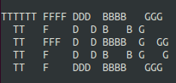
Cloud Pipeline
...
7.Streaming of requests
1. Data Preparation using Spark
2. Explore data using Jupyter notebook
3. Train the model using TensorFlow
4. Monitor training progress using TensorBoard
5. Debug Model using tfdbg
6. Serve Model using TensorFlow Serving

Slide 13

Open Source Pipeline
KUDO
1. Data Preparation using Spark
7. Kafka stream of requests
2. Explore data using Jupyter notebook
3. Train the model using TensorFlow
4. Monitor training progress using TensorBoard
5. Debug Model using tfdbg
6. Serve Model using TensorFlow Serving
KUBEFLOW
Notes:
TFDB not 100% but can be done ….

Slide 14
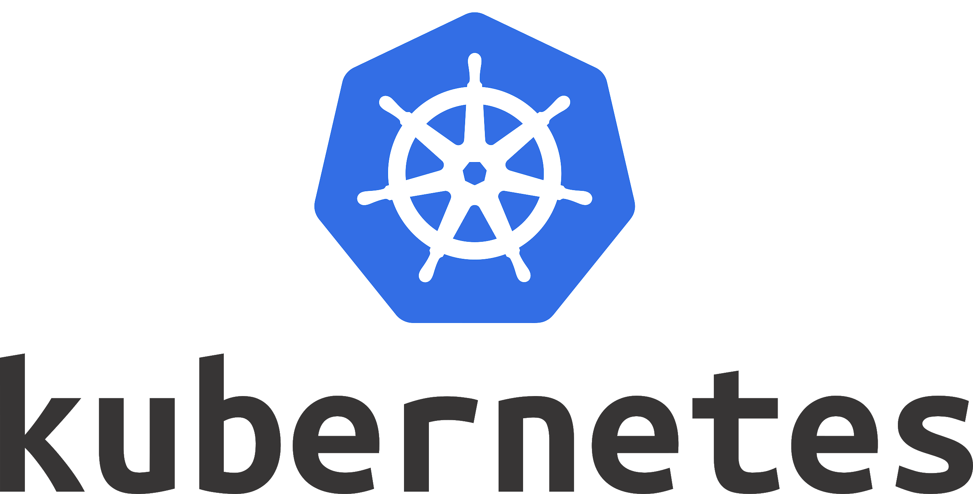
Kubernetes
Focused initially for purely stateless workloads
Scheduler can move pods around
Notes:
Kubernetes was originally very focused on stateless application architecture. One of the fundamental features of Kubernetes is that the scheduler can move pods around between agents, which works fine for stateless applications but not so well for stateful, which tend to like their storage and networking not to change during operation, unless handled in a very specific operational way.

Slide 15
Stateless Applications
Service v1.0
No state persisted
Client
Load Balancer
Service v1.0
Notes:
Kubernetes and other orchestration systems built around declarative state work very well for stateless applications. A stateless app is a program that does not save client data generated in one session for use in the next session with that client. Each session is carried out as if it was the first time and responses are not dependent upon data from a previous session. In practice that means that we can stop and start our stateless application, and it will just start executing.
Ephemeral
Binary
Isolation

Slide 16
Stateless Applications
Service v1.0
No state persisted
Easy to scale up / down
Client
Load Balancer
Service v1.0
Service v1.0
Notes:
In general we’d run this kind of application behind a load balancer, and we can scale these up or down by adding or removing instances. We can also deploy new versions very easily by simply replacing all of the running instances. We can have various ordering strategies for performing these tasks, for example blue/green deployments for testing new versions, but fundamentally the management of these applications is binary, we are either running or we’re not.
Stateless applications are intrinsically intertwined in the mover towards microservices architecture, where we connect together many very simple applications which each have a particular well bounded function, and to the adoption of container technologies to manage them, because they are fundamentally well suited to the patterns which systems like Kubernetes give us. We simply declare that we want a specific number of an application to exist, and Kubernetes will create them for us. It’s basically a binary process, they are running or not, and we don’t have to worry about any complex operations to configure them before we start deploying.

Slide 17
Stateless Applications
Service v2.0
No state persisted
Easy to scale up / down
Client
Load Balancer
Service v1.0
Service v1.0
Notes:
In general we’d run this kind of application behind a load balancer, and we can scale these up or down by adding or removing instances. We can also deploy new versions very easily by simply replacing all of the running instances. We can have various ordering strategies for performing these tasks, for example blue/green deployments for testing new versions, but fundamentally the management of these applications is binary, we are either running or we’re not.
Stateless applications are intrinsically intertwined in the move towards microservices architecture, where we connect together many very simple applications which each have a particular well bounded function, and to the adoption of container technologies to manage them, because they are fundamentally well suited to the patterns which systems like Kubernetes give us. We simply declare that we want a specific number of an application to exist, and Kubernetes will create them for us. It’s basically a binary process, they are running or not, and we don’t have to worry about any complex operations to configure them before we start deploying.

Slide 18
Stateless Applications
Service v2.0
No state persisted
Easy to scale up / down
Client
Load Balancer
Service v2.0
Service v1.0
Notes:
In general we’d run this kind of application behind a load balancer, and we can scale these up or down by adding or removing instances. We can also deploy new versions very easily by simply replacing all of the running instances. We can have various ordering strategies for performing these tasks, for example blue/green deployments for testing new versions, but fundamentally the management of these applications is binary, we are either running or we’re not.
Stateless applications are intrinsically intertwined in the mover towards microservices architecture, where we connect together many very simple applications which each have a particular well bounded function, and to the adoption of container technologies to manage them, because they are fundamentally well suited to the patterns which systems like Kubernetes give us. We simply declare that we want a specific number of an application to exist, and Kubernetes will create them for us. It’s basically a binary process, they are running or not, and we don’t have to worry about any complex operations to configure them before we start deploying.

Slide 19
Stateless Applications
Service v2.0
No state persisted
Easy to scale up/down
Straightforward to upgrade
Client
Load Balancer
Service v2.0
Service v2.0
Notes:
In general we’d run this kind of application behind a load balancer, and we can scale these up or down by adding or removing instances. We can also deploy new versions very easily by simply replacing all of the running instances. We can have various ordering strategies for performing these tasks, for example blue/green deployments for testing new versions, but fundamentally the management of these applications is binary, we are either running or we’re not.
Stateless applications are intrinsically intertwined in the mover towards microservices architecture, where we connect together many very simple applications which each have a particular well bounded function, and to the adoption of container technologies to manage them, because they are fundamentally well suited to the patterns which systems like Kubernetes give us. We simply declare that we want a specific number of an application to exist, and Kubernetes will create them for us. It’s basically a binary process, they are running or not, and we don’t have to worry about any complex operations to configure them before we start deploying.

Slide 20
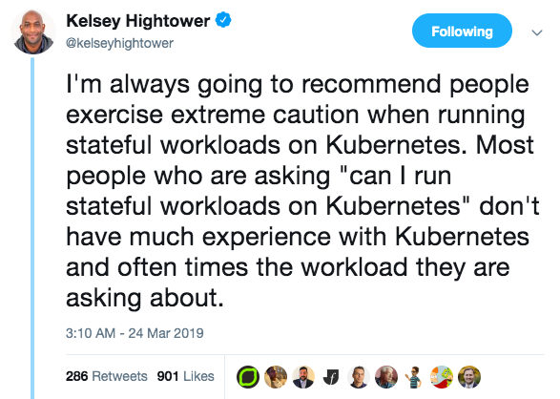
Kubernetes
Notes:
No slide deck would be complete without a quote from Kelsey Hightower (or some dank memes, which I don’t have - too old)
Manual considerations
Automate away pain and toil

Slide 21
Stateful Applications
Client
Service
Data
Notes:
So if all applications were stateless, then the world of application deployment would be super simple, and sometimes in our industry you could get the idea that that’s the case in the era of microservices. But unfortunately that’s not actually true. The second class of applications are stateful, where the app is retaining data or state across it’s entire lifecycle. Whilst older more monolithic applications such as SQL databases fit into this paradigm, there are also many architectures where the individual elements making up a particular service are actually clustered together in some way. They may be sharing state data between them, or they need to be synchronised together in some way.
Distributed stateful apps

Slide 22
Stateful Applications
Client
Service
Instance
Instance
Instance
Notes:
This is a lot more complicated and is a whole area of computer science unto itself.
Typically these kinds of applications have a set of lifecycle states which require logical ordering of actions in order to maintain operation. In general we can’t just start and stop instances and expect the overall service to continue to operate, we may need to wait for rebalancing of data, or there may be multiple steps involved in an upgrade operation. This applies to upgrading, scaling and failure scenarios and these operational strategies require domain specific knowledge to manage. They also tend to be unique to the application, so those operations for a Cassandra cluster are different from a Kafka cluster, or an HDFS deployment.

Slide 23
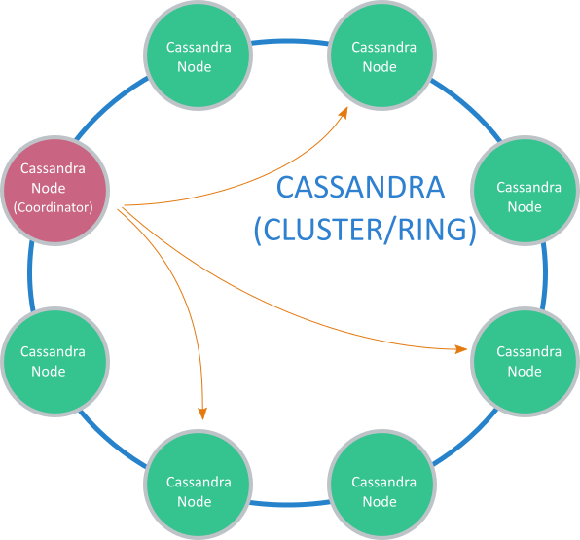
Distributed Stateful Applications
Notes:
This is a lot more complicated and is a whole area of computer science unto itself.
Typically these kinds of applications have a set of lifecycle states which require logical ordering of actions in order to maintain operation. In general we can’t just start and stop instances and expect the overall service to continue to operate, we may need to wait for rebalancing of data, or there may be multiple steps involved in an upgrade operation. This applies to upgrading, scaling and failure scenarios and these operational strategies require domain specific knowledge to manage. They also tend to be unique to the application, so those operations for a Cassandra cluster are different from a Kafka cluster, or an HDFS deployment.

Slide 24
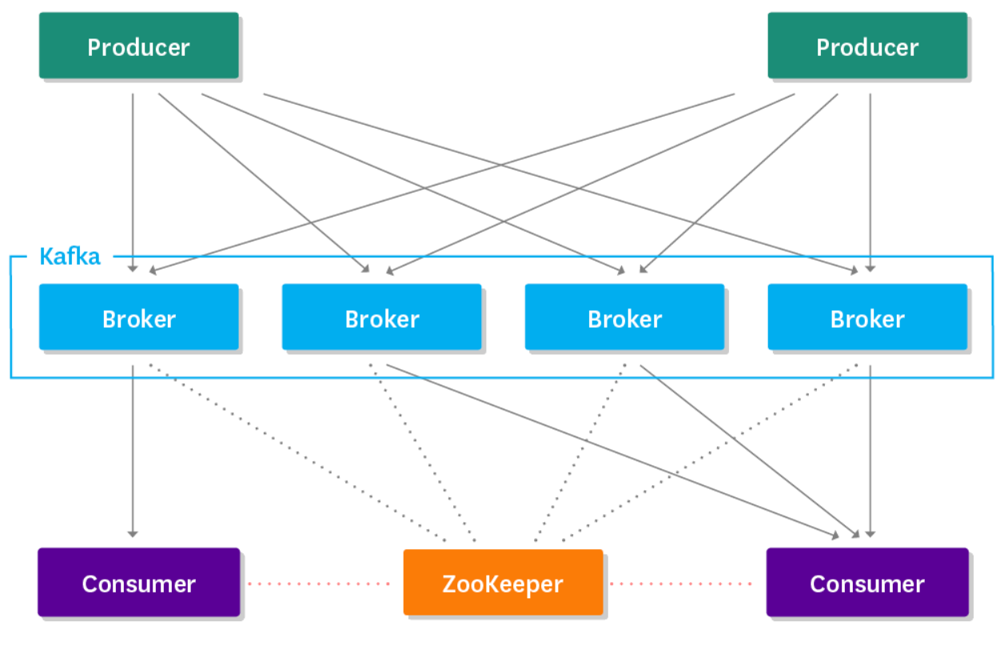
Distributed Stateful Applications
Notes:
This is a lot more complicated and is a whole area of computer science unto itself.
Typically these kinds of applications have a set of lifecycle states which require logical ordering of actions in order to maintain operation. In general we can’t just start and stop instances and expect the overall service to continue to operate, we may need to wait for rebalancing of data, or there may be multiple steps involved in an upgrade operation. This applies to upgrading, scaling and failure scenarios and these operational strategies require domain specific knowledge to manage. They also tend to be unique to the application, so those operations for a Cassandra cluster are different from a Kafka cluster, or an HDFS deployment.

Slide 25
Challenges without KUDO
Kubernetes
Distributed systems at scale
This application’s function
9+ months
KLOCs
Duplicate coding
Maintenance
Requires advanced knowledge of:
Go or other programming
Notes:
Even if you build your Operator, it won’t necessarily be simple to consume. Without standardization, every Operator will have its own APIs, it own debugging tools, its own workflows, etc. If your cluster has five or six Operators, each with their own controller, managing them in concert means significant operational overhead (aka, “controller sprawl”). That’s where KUDO comes in.

Slide 26

Kubernetes Operators
Orchestrate stateful applications using K8s API
Extend API using Custom Resource Definitions
Encode domain specific operational knowledge
Upgrades
Failure and Recovery Scenarios
Scaling up / down
Purpose built per application
“Kubernetes is an Operations API”:
https://blog.atomicinc.com/2018/05/23/kubernetes-is-an-operations-api/
Notes:
The emerging solution to this problem is the Operator pattern. Operators basically encapsulate operational tasks in code, which can either be run when an API is invoked, automatically as required or on a schedule, so we can orchestrate application lifecycle actions using Kubernetes API’s/ So Operators encode domain specific knowledge about the lifecycle actions required for the application - how do I scale it, how do I upgrade it, how do I deal with failure scenarios, and they achieve all of this using native k8s API’s.
Application-specific controller
Reference blog post and how it bemoans YAML - see later slide

Slide 27
KUDO Concepts - Plan
Orchestrate tasks through phases and steps
A structured ‘runbook’ which can then be executed by software
Typically define several plans:
Deploy
Backup
Restore
Upgrade
Phases and steps can be run serial or parallel
Plan foo
├─ Phase bar
│ ├─ Step qux
│ └─ Step quux
└─ Phase baz
├─ Step quuz
├─ Step corge
└─ Step grault
Notes:
Plans are how KUDO operators convey progress through service management operations, such as deployment, scaling, upgrading. A plan is composed of phases, these contain made up of steps and these in turn are made up of tasks.
"Plans orchestrate tasks through phases and steps. Plans consists of one or more phases. Phases consists of one or more steps. Steps contain one or more tasks. Both phases and also steps can be configured with an execution strategy, either serial or parallel."

Slide 28
KUDO Concepts - PlanExecution
Defines inputs and status of an instance’s executable plans
Each execution of a Plan has its own CRD
Plan(s) for "mysql" in namespace "default":
.
└── mysql (Operator-Version: "mysql-0.1.0" Active-Plan: "mysql-restore")
├── Plan backup (serial strategy) [NOT ACTIVE]
│ └── Phase backup (serial strategy) [NOT ACTIVE]
│ └── Step backup (serial strategy) [NOT ACTIVE]
│ ├── pv [NOT ACTIVE]
│ ├── backup [NOT ACTIVE]
│ └── cleanup [NOT ACTIVE]
├── Plan deploy (serial strategy) [NOT ACTIVE]
│ └── Phase deploy (serial strategy) [NOT ACTIVE]
│ └── Step deploy (serial strategy) [NOT ACTIVE]
│ ├── deploy [NOT ACTIVE]
│ ├── init [NOT ACTIVE]
│ └── cleanup [NOT ACTIVE]
Notes:
When a plan is executed, a corresponding PlanExecution CRD is stored with inputs and status of the plan.

Slide 29
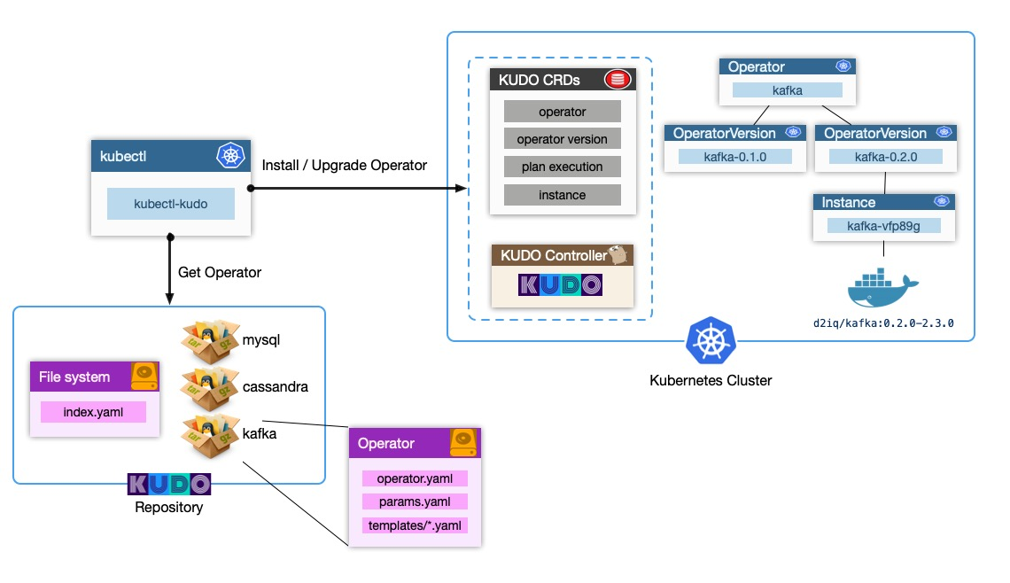
KUDO Concepts - Architecture
Notes:
Kudo also includes a CLI extension to kubectl, which allows us to run kudo specific commands natively in kubectl. Note that you can just use kubectl, it’s all just Kubernetes - nothing proprietary!

Slide 30
KUDO Operators
Beta in October
GA in October
Beta in October
Notes:
When we started to look at the operator landscape, it seemed like this was a familiar problem space. We saw developers having to implement the same steps, with a lot of complexity being expressed in number of lines of code and time to implement. So taking the lessons we’d learned from the dcos-commons SDK, we created the Kudo project with the aim of simplifying operator development.
Kudo is an acronym for Kubernetes Universal Declarative Operator. Rather than implementing a custom operator for each application, Kudo provides a universal operator with the concepts of plans built into it, and allowing operator developers to define a lot of the code declaratively in YAML. Kudo is built on top of kubebuilder, so you can also think of it as a way of simplifying kubebuilder based development. It’s a fully open source project, and we’re actively working to build community around it.
The Kubernetes Universal Declarative Operator (KUDO) is a highly productive toolkit for writing Kubernetes Operators, with a focus on Day 2 operations for distributed data services.
Includes a universal controller that can be configured via declarative YAML specs to manage multiple workloads
Inspired by DC/OS Commons, a similar toolkit for orchestrating data services on Apache Mesos

Slide 31
DEMO TIME!
Install KUDO
Review Operator Structure, Install and Uninstall
First-Operator
Customize Operator, Scale / Update Parameters
Second-Operator
Reviewed KUDO Plans and Status:
Zookeeper
Upgraded KUDO Operator / Application
Kafka

Slide 32

Demo - https://butt.holdings

Slide 33

Demo

Slide 34
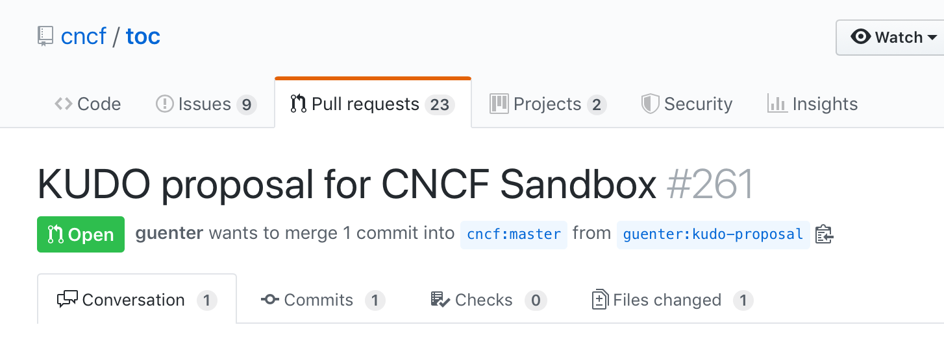
KUDO Future - CNCF

Slide 35
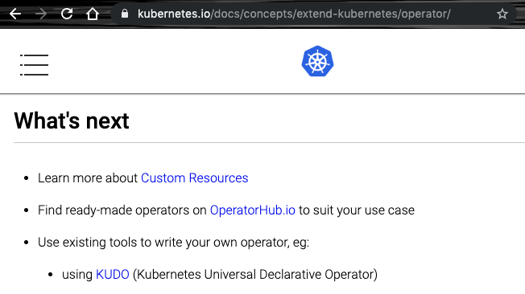
Use the Kubernetes recommended operator framework!

Slide 36
KUDO Community - Get Involved!
https://kudo.dev/
https://github.com/kudobuilder/kudo
#kudo http://slack.k8s.io/
https://groups.google.com/forum/#!forum/kudobuilder
Community Meeting - weekly Thursdays 10am PT

Slide 37
Appendix

Slide 38
Operator Development
Operator Framework
RedHat / IBM project
Implement using Ansible, Helm charts, or Go
Existing implementations often don’t cover the entire lifecycle
Ansible and Helm are limited. Go requires 1,000s of lines of controller code
Kubebuilder
Kubernetes SIG API Machinery sub-project
Operators written in Go with a focus on code generation
Existing implementations often don’t cover the entire lifecycle
KUDO
Universal Operator
Built using community projects (Kubebuilder, Kustomize, ...)
Write Operators as templated YAML manifests
Provide high level CRDs that represent workloads
Focused on higher level coordination of software lifecycles
“Day 2 Operators”
Notes:
So in comparison to the other ways of building operators, Kudo can create complete operators without needing either deep knowledge of Kubernetes, or writing any code. Simply by defining lifecycle phases and actions in YAML we can orchestrate lifecycle actions, using the built in CRD’s which Kudo provides. KUDO is ultimately just Kubernetes. There’s no DSL to learn, proprietary APIs, or external datastores required to work with KUDO. As a result, it’s easier to learn, supports native Kubernetes tooling (such as Kustomize and kubectl), and maps to the same resource model as other Kubernetes resources.

Slide 39
Input Data Management
Challenges
- Training/Dev/Test + Incoming Data (Large amounts)
- Quality
- Availability (for cluster)
- Velocity
Streaming
Solutions
GFS
Solutions
GFS
Apache Kafka
Apache Cassandra

Slide 40

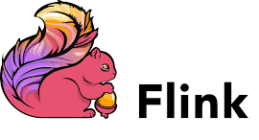
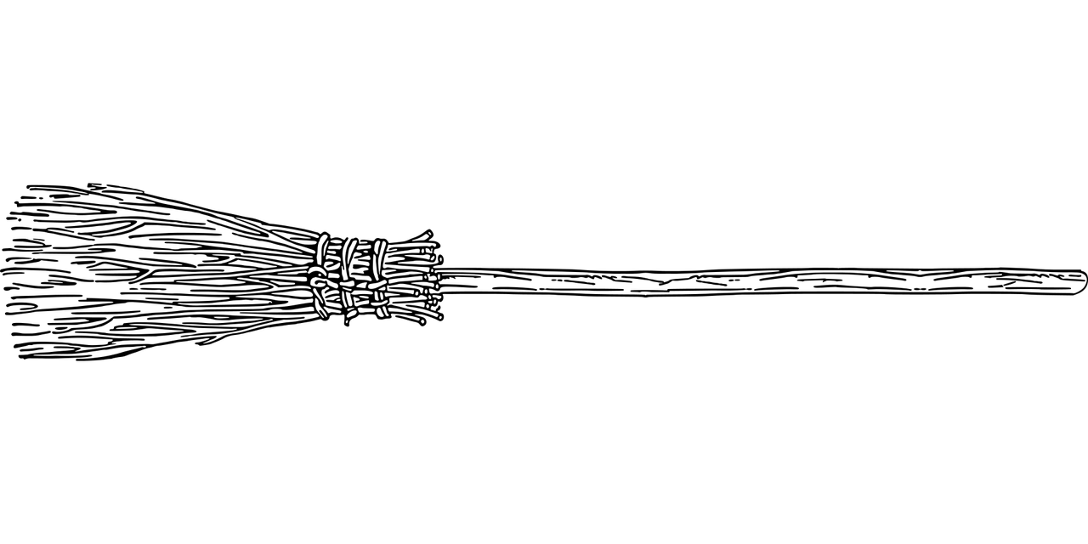
Data Preparation
Challenges
Data is typically not ready to be consumed by ML job*
Data Cleaning
Missing/incorrect labels
Data Preparation
Same Format
Same Distribution
Solutions

Slide 41

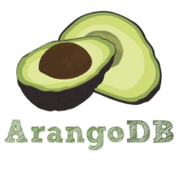
Model Management
Challenges
Many Models
Different Hyperparameter
Different Models
New Training Data
...
Solutions
Persistent Storage + Metadata
GFS

